Slide 1
RDBMS

Slide 2
Databases vs Flat Files
Data independence and efficient access
Reduced application development time
Data integrity and security
Protect data from inconsistency due to multiple concurrent users
Crash recovery
Security and access control
Etc etc

Slide 3
Relational Model
Proposed by Edgar. F. Codd in the early seventies
Most of the modern DBMS are relational
Simple and elegant model with a mathematical basis
Led to the development of a theory of data dependencies and database design
Relational algebra operations
crucial role in query optimization and execution
Laid the foundation for the development of Database standard SQL

Slide 4
Relation
An association between two or more data elements
Resembles a “Table” of records.
Consider the relation EMPLOYEE represented by the below
emp_id | name | ssn | desig_id | salary | join_date | dept_id
1011 | ABC | a3232x3444 | 5 | 100000 | 01/01/11 | 2

Slide 5
Tuples of a Relation
Each row here is a tuple
Relation is a set of tuples
emp_id | name | ssn | desig_id | salary | join_date | dept_id
1011 | ABC | a3232x3444 | 5 | 100000 | 01/01/11 | 2

Slide 6
Cardinality of a RELATION
Is the number of tuples in a relation at a point in time
emp_id | name | ssn | desig_id | salary | join_date | dept_id
1011 | ABC | a3232x3444 | 5 | 100000 | 01/01/11 | 2
1
2
3
4
Cardinality = 4

Slide 7
Attributes
A tuple consists of attribute values
emp_id | name | ssn | desig_id | salary | join_date | dept_id
1011 | ABC | a3232x3444 | 5 | 100000 | 01/01/11 | 2

Slide 8
Arity / Degree
Is the number of attributes in a relation
emp_id | name | ssn | desig_id | salary | join_date | dept_id
1011 | ABC | a3232x3444 | 5 | 100000 | 01/01/11 | 2
Arity / Degree = 7

Slide 9
Domain
Defines the space of possible values for an attribute
emp_id | name | ssn | desig_id | salary | join_date | dept_id
1011 | ABC | a3232x3444 | 5 | 100000 | 01/01/11 | 2

Slide 10
Domain - Example
Emp_id | integer | Set of all 4 digital numbers
name | Varhar(50) | Set of alpha characters. Max length 50
ssn | Varchar(10) | Set of alpha numeric characters. Max length 10
desig_id | smallint | Set of all designation codes
salary | decimal | Decimal
join_date | date | date
dept_id | smallint | Set of all department ids

Slide 11
Relation Schema
Consists of name of relation + attributes (along with domain)
Table definition
emp_id | name | ssn | desig_id | salary | join_date | dept_id
1011 | ABC | a3232x3444 | 5 | 100000 | 01/01/11 | 2

Slide 12
DEFINITION SUMMARY
Formal Terms | Informal Terms
Relation | Table
Attribute | Column
Tuple | Row
Domain | Data type in the column
Schema of a Relation | Table definition

Slide 13
Super Key
Uniqueness property: No two tuples have the same value for the key
Time-independent
emp_id | name | ssn | desig_id | salary | join_date | dept_id
1011 | ABC | a3232x3444 | 5 | 100000 | 01/01/11 | 2
Super Keys: emp_id
emp_id, name, ssn
emp_id_name,ssn_design_d,salary,join_date,dept_id

Slide 14
Candidate Key
Uniqueness property: No two tuples shave the same value for the key
Minimality property: None of the attributes of the key can be discarded from the key without destroying the uniqueness property.
Super key reduced to minimum number of columns
emp_id | name | ssn | desig_id | salary | join_date | dept_id
1011 | ABC | a3232x3444 | 5 | 100000 | 01/01/11 | 2

Slide 15
Primary Key
One of the candidate keys is chosen to uniquely identify tuples in a relation, such a key is called the primary key.
There can be only one primary key per relation
Primary key may be a compound key
emp_id | name | ssn | desig_id | salary | join_date | dept_id
1011 | ABC | a3232x3444 | 5 | 100000 | 01/01/11 | 2

Slide 16
Alternate Key
Any candidate Key which is not a primary key is an alternate key
There can be more than one alternate keys for any relation.
emp_id | name | ssn | desig_id | salary | join_date | dept_id
1011 | ABC | a3232x3444 | 5 | 100000 | 01/01/11 | 2

Slide 17
Foreign Key
Some times a set of attributes in a relation may point to certain tuples in another relation
A foreign key is a set of attributes in one relation whose values are required to match one of the values of the primary key of the same or different relation.
There can be more than one foreign key in a given relation.
emp_id | name | ssn | desig_id | salary | join_date | dept_id
1011 | ABC | a3232x3444 | 5 | 100000 | 01/01/11 | 2
dept_id | dept_name
2 | Software Engineering

Slide 18
Entity Integrity
No attribute participating in the primary key of a base relation may accept null values
Guarantees that each entity will have a unique identity.

Slide 19
Relational database schema
A set S of relation schemas that belong to the same database
S is the name of the whole database schema
S = {R1, R2, ..., Rn}
R1, R2, …, Rn are the names of the individual relation schemas within the database S

Slide 20
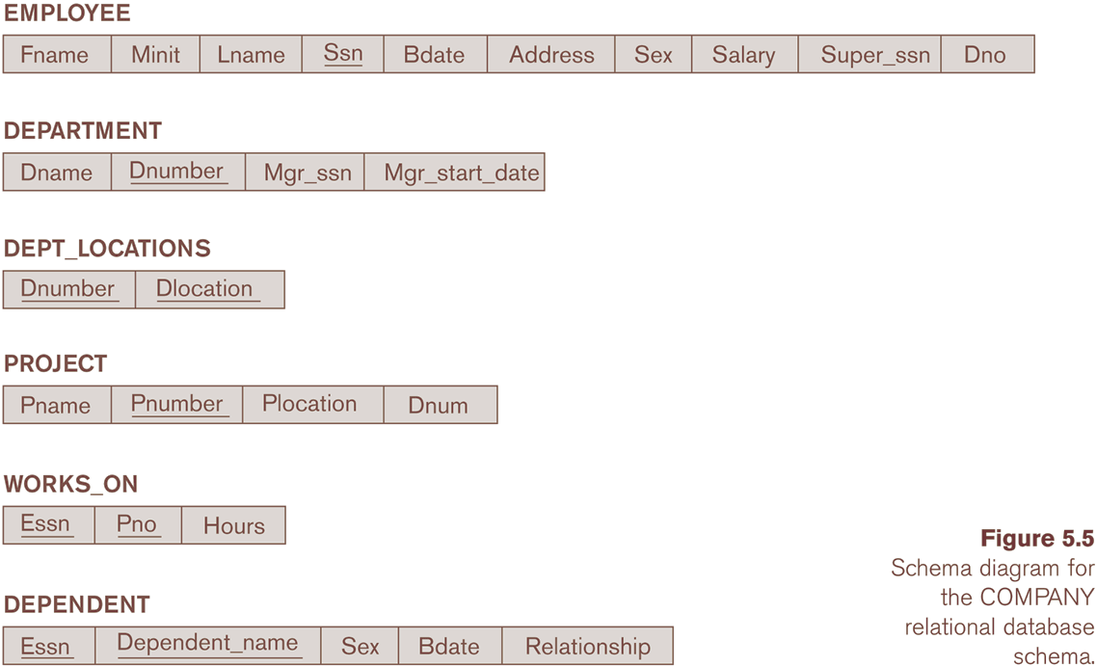
Schema Diagram for the COMPANY

Slide 21
Referential Integrity
Values of the foreign key
Must be either null or
If non-null, must match with the primary key value of some tuple of the ‘parent’ relation. The reference can be the same relation.
Explain with Example

Slide 22
Relational Algebra
The basic set of operations for the relational model is known as the relational algebra. These operations enable a user to specify basic retrieval requests.
Gives a procedural method of specifying a retrieval query.
A set of operators (unary and binary) that take relation instances as arguments and return new relations.
Forms the core component of a relational query engine.
SQL queries are internally translated into RA expressions.
Provides a framework for query optimization.
The result of a retrieval is a new relation, which may have been formed from one or more relations. The algebra operations thus produce new relations, which can be further manipulated using operations of the same algebra.

Slide 23
Selection
SELECT Operation
SELECT operation is used to select a subset of the tuples from a relation that satisfy a selection condition. It is a filter that keeps only those tuples that satisfy a qualifying condition – those satisfying the condition are selected while others are discarded.
Example: To select the EMPLOYEE tuples whose department number is four or those whose salary is greater than 30,000 the following notation is used:
σDNO = 4 (EMPLOYEE)
σSALARY > 30,000 (EMPLOYEE)
In general, the select operation is denoted by _{σ <selection condition>}(R) where the
symbol σ (sigma) is used to denote the select operator, and the selection condition is a Boolean expression specified on the attributes of relation R

Slide 24
Select Operation – Example
Relation r
A
B
C
D
α
α
β
β
α
β
β
β
1
5
12
23
7
7
3
10
The degree of the new relation is the same. The cardinality is different.
Commutative operator
σ_{A=B &D > 5} (r)
A
B
C
D
α
β
α
β
1
23
7
10

Slide 25
Projection
PROJECT Operation
This operation selects certain columns from the table and discards the other columns. The PROJECT creates a vertical partitioning – one with the needed columns (attributes) containing results of the operation and other containing the discarded Columns.
Example: To list each employee’s first and last name and salary, the following is used:
π_{LNAME, FNAME,SALARY}(EMPLOYEE)
The general form of the project operation is π<attribute list>(R) where π (pi) is the symbol used to represent the project operation and <attribute list> is the desired list of attributes from the attributes of relation R.
The project operation removes any duplicate tuples, so the result of the project operation is a set of tuples and hence a valid relation.

Slide 26
Project Operation – Example
A
B
C
Relation r:
α
α
β
β
10
20
30
40
1
1
1
2
A
C
A
C
∏_{A,C} (r)
α
α
β
β
1
1
1
2
α
β
β
1
1
2
=
Output is another relation with a different schema.
Non- Commutative

Slide 27
Union
UNION Operation
The result of this operation, denoted by R ∪ S, is a relation that includes all tuples that are either in R or in S or in both R and S. Duplicate tuples are eliminated.
For r ∪ s to be valid.
1. r, s must have the same arity (same number of attributes)
2. The attribute domains must be compatible (e.g., 2nd column of r deals with the same type of values as does the 2nd column of s)
E.g. to find all customers with either an account or a loan ∏_{customer-name} (depositor) ∪ ∏_{customer-name} (borrower

Slide 28
Union Operation – Example
Relations r, s:
A
B
A
B
α
α
β
1
2
1
α
β
2
3
s
r
r ∪ s:
A
B
α
α
β
β
1
2
1
3

Slide 29
INTERSECTION
INTERSECTION OPERATION
The result of this operation, denoted by R ∩ S, is a relation that includes all tuples that are in both R and S. The two operands must be "type compatible"
Relations r, s:
A
B
A
B
α
α
β
1
2
1
α
β
2
3
s
r
r ∩ s:
A
B
α
2

Slide 30
Difference (or MINUS) Operation
The result of this operation, denoted by R - S, is a relation that includes all tuples that are in R but not in S. The two operands must be "type compatible”.
Relations r, s:
A
B
A
B
α
α
β
1
2
1
α
β
2
3
s
r
r − s:
A
B
α β
1 1

Slide 31
CARTESIAN (or cross product) Operation
Relations r, s:
A
B
C
D
E
α
β
1
2
α
β
β
γ
10
10
20
10
a
a
b
b
r
s
A
B
C
D
E
r x s:
α
α
α
α
β
β
β
β
1
1
1
1
2
2
2
2
α
β
β
γ
α
β
β
γ
10
10
20
10
10
10
20
10
a
a
b
b
a
a
b
b

Slide 32
Composition of Operations
Can build expressions using multiple operations
Example: σ_{A=C}(r x s)
r x s
σ_{A=C}(r x s)
A
B
C
D
E
α
α
α
α
β
β
β
β
1
1
1
1
2
2
2
2
α
β
β
γ α
β
β
γ
10
19
20
10
10
10
20
10
a
a
b
b
a
a
b
b
A
B
C
D
E
α
β
β
1
2
2
α
β
β
10
20
20
a
a
b

Slide 33
Natural-Join Operation
Notation: r * s
The result of the natural join is the set of all combinations of tuples in R and S that are equal on their common attribute names.
The standard definition of natural join requires that the two join attributes, or each pair of corresponding join attributes, have the same name in both relations. If this is not the case, a renaming operation is applied first.

Slide 34
Natural Join Operation – Example
Relations r, s:
A
B
C
D
B
D
E
α
β
γ
α
δ
1
2
4
1
2
α
γ
β
γ
β
a
a
b
a
b
1
3
1
2
3
a
a
a
b
b
α
β
γ
δ
∈
r
s
r * s
A
B
C
D
E
α
α
α
α
δ
1
1
1
1
2
α
α
γ
γ
β
a
a
a
a
b
α
γ
α
γ
δ

Slide 35
Theta Join Operator
Theta join is used to combine related tuples from two or more relations ( specified by the condition theta ), to form a single tuple.
The general form of theta join is as follows :
R (join condition) S. where R and S are relation and join condition is a logical expression over attributes of R and S .
Tuples whose join attributes are null do not appear in the final result.
Theta join where the only comparison operator used is the equals (=) sign, are called equijoins .

Slide 36
Theta Join Operator – Example
Relations r, s:
A
B
C
D
B
D
E
α
β
γ
α
δ
1
2
4
1
2
α
γ
β
γ
β
a
a
b
a
b
1
3
1
2
3
a
a
a
b
b
α
β
γ
δ
∈
r
s
r (r.b = s.b and r.d = s.d) s
A
B
C
D
E
α
α
α
α
δ
1
1
1
1
2
α
α
γ
γ
β
a
a
a
a
b
α
γ
α
γ
δ

Slide 37
Outer Join
An extension of the join operation that avoids loss of information.
Computes the join and then adds tuples form one relation that does not match tuples in the other relation to the result of the join.

Slide 38
Outer Join – Example
Relation loan
loan-number
branch-name
amount
L-170
L-230
L-260
Downtown
Redwood
Perryridge
3000
4000
1700
Relation borrower
customer-name
loan-number
Jones
Smith
Hayes
L-170
L-230
L-155

Slide 39
Join Examples
Inner Join loan Borrower
loan-number
branch-name
amount
customer-name
L-170
L-230
Downtown
Redwood
3000
4000
Jones
Smith
Left Outer Join
loan borrower
loan-number
branch-name
amount
customer-name
L-170
L-230
L-260
Downtown
Redwood
Perryridge
3000
4000
1700
Jones
Smith
null

Slide 40
Outer Join – Example
Right Outer Join
loan borrower
loan-number
branch-name
amount
customer-name
L-170
L-230
L-155
Downtown
Redwood
null
3000
4000
null
Jones
Smith
Hayes
Full Outer Join
loan borrower
loan-number
branch-name
amount
customer-name
L-170
L-230
L-260
L-155
Downtown
Redwood
Perryridge
null
3000
4000
1700
null
Jones
Smith
null
Hayes

